Slide 1
Problem Statement:-
In today's world even big giants of tech are stealing user’s data in the name of more convenient user experience, but in the world of "More Convenient User Experience" we forgot terms like privacy and confidentiality.
Solution Proposed:-
This is an information security project where the sender will send a message which will be encrypted and embedded in an Image provided by the sender and the receiver will be able to see those images in his/her inbox .The details of the sender will be disclosed after retrieval & decryption of the message from the image. Once the receiver will read the message it'll be deleted automatically for a traceless conversation.

Slide 2
Motivation :-
Image steganography and cryptography are two methods used to protect information but they do so in different ways. While image steganography hides the existence of the message by embedding it in an image cover, cryptography scrambles the message so that it cannot be read without the key. Combining these two methods increases security and makes it harder for the intruder to even know the secret is there, let alone solve it. [5]
Proposed Method:-
The message will be encrypted using symmetric cryptography.
Common key is generated using sender's and receiver's name
A multiple-bit embedding method is used to embed the data into the cover image.
Uncompressed data is used for the embedding process.
This project allows text data to be hidden securely.
Micro services been used for increase scalability
All common image formats are supported, including PNG, JPG, and others.

Slide 3
Technology Used:-
ReactJS: Builds dynamic, user-friendly interfaces for better usability.
Java: Implements precise image processing for steganography operations.
Spring Boot: Ensures secure, scalable sender-receiver communication.
Maven: Manages project building and simplifies dependency integration.
ImageIO: Handles diverse image formats for reliable compatibility.

Slide 4
Cryptography Design:-
Common key (p)
F(s,r)
Sender’s name
Image
Receiver’s name
F(m,p)
Session key (pk)
F(E,i)
Message(m)
F(m,pk)
Cypher Text (E)
Communication channel
Original message
F(pk,P)
Encrypted Text (E)
Receiver
Session key (pk)
F(E,p)
Common key (p)
F(s,r)
Receiver’s name
Sender’s name

Slide 5
Cryptography Algorithm:-
1.Session key generation:- First the message and common key will be compared and after that 3 cases will be found.
If password length is equal to message length, then the session key will be the common key which isn’t recommended at all.
If common key length is greater than message length, then each character will be subtracted from its next character just to make some different session key than common key
If common key length is greater than message length, then each character will be added with its next character and append with the common key until the length of both common key and message will be equal.

Slide 6
2. Encryption: -
Now for each character of massage we got one character from key we will simply add their ANSII value.
Then we will take the remainder after dividing it with 128.
Now we will add 32 with them.
And if there is a space will keep the space there .
3. Decryption: -
Now for each character of massage we got one character from key we will simply add their ANSII value.
Now we will subtract 32 from them.
Then we will take the remainder after dividing the value with 128.

Slide 7
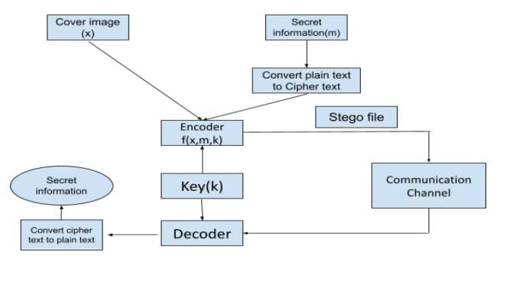
Steganography Design:-
Let see the implementation…

Slide 8
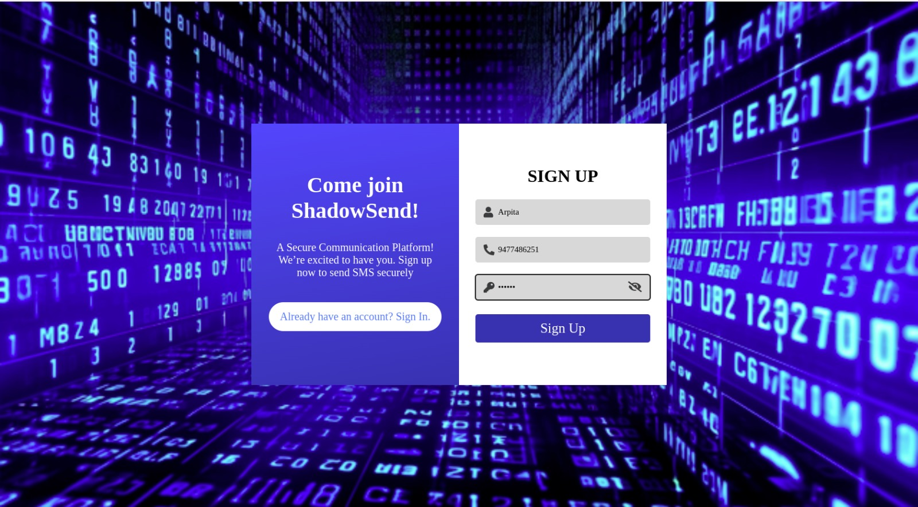
Overview of Project
SignUp:

Slide 9
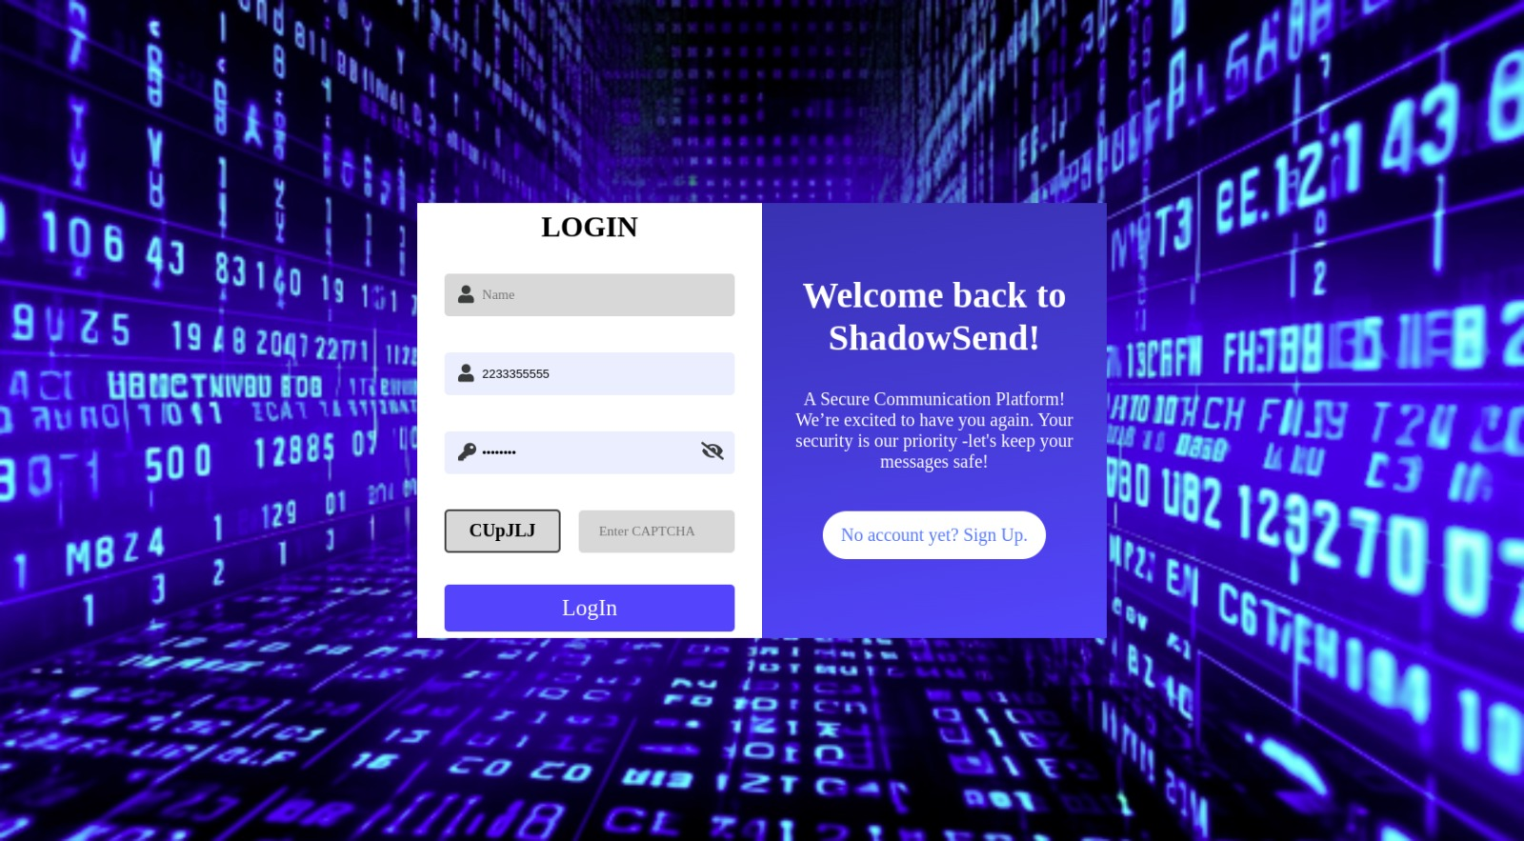
LogIn:

Slide 10
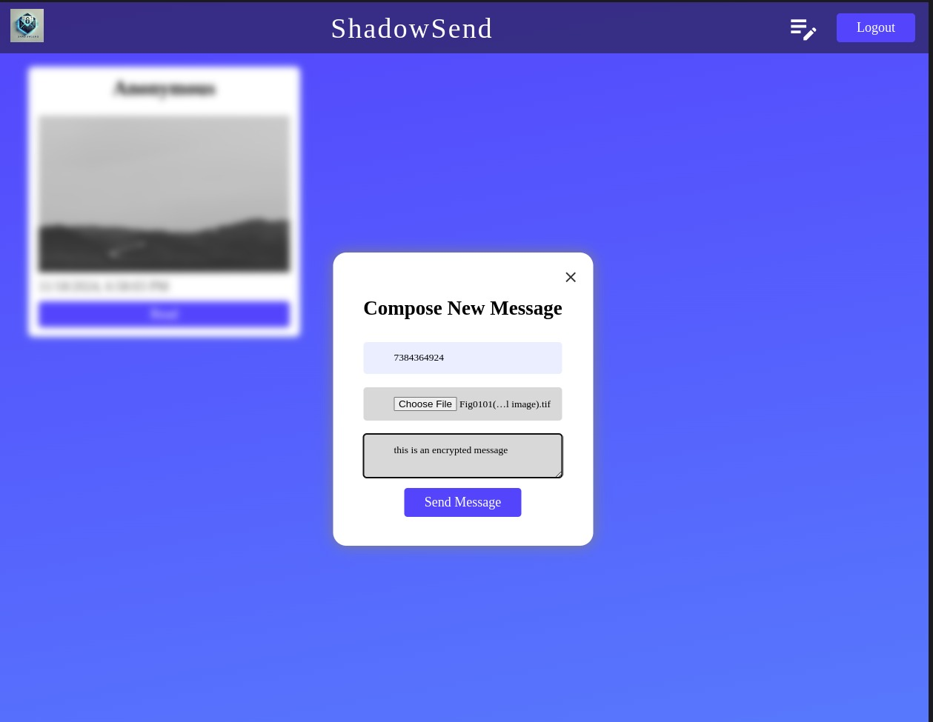
Message Sending Window:

Slide 11
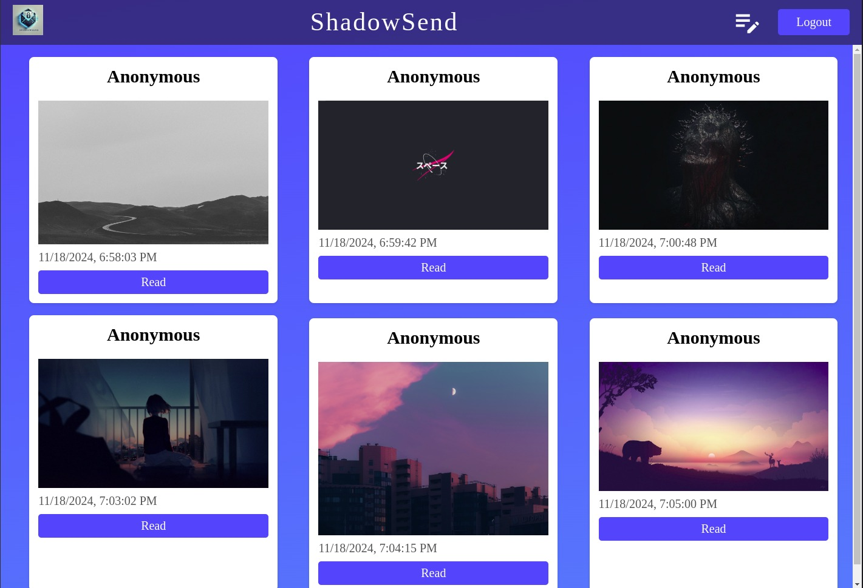
Inbox:

Slide 12
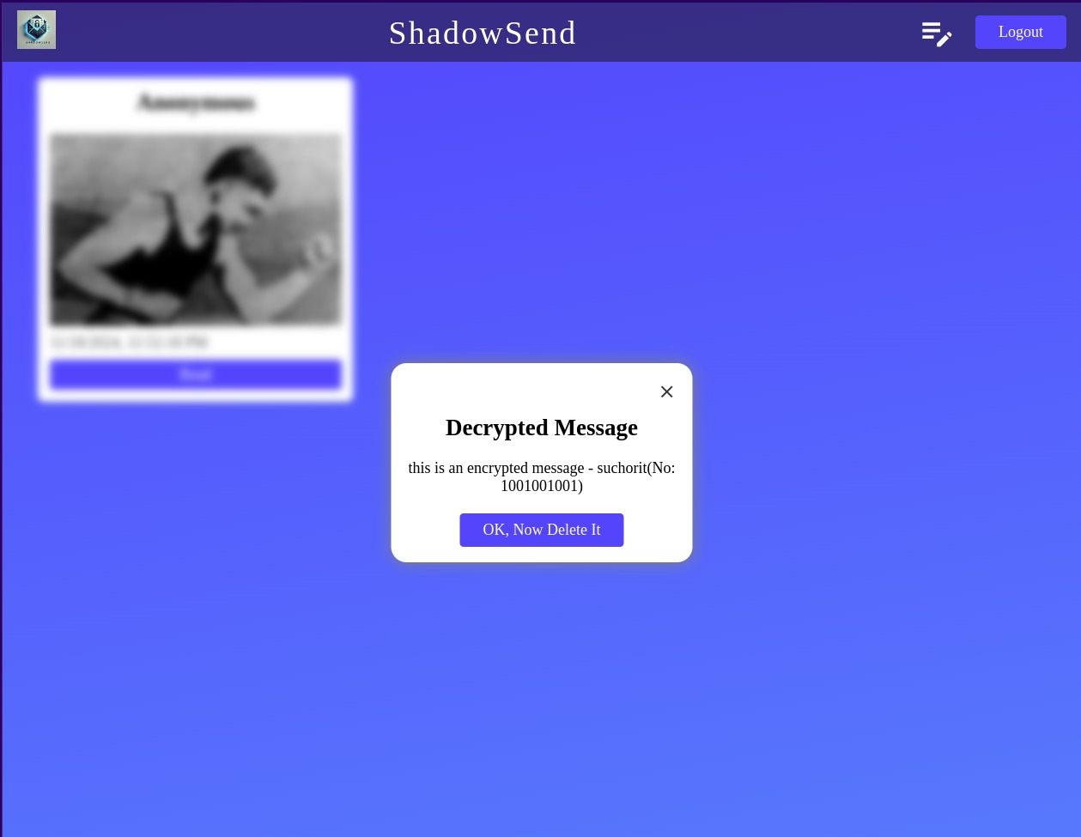
Decryption Window:

Slide 13
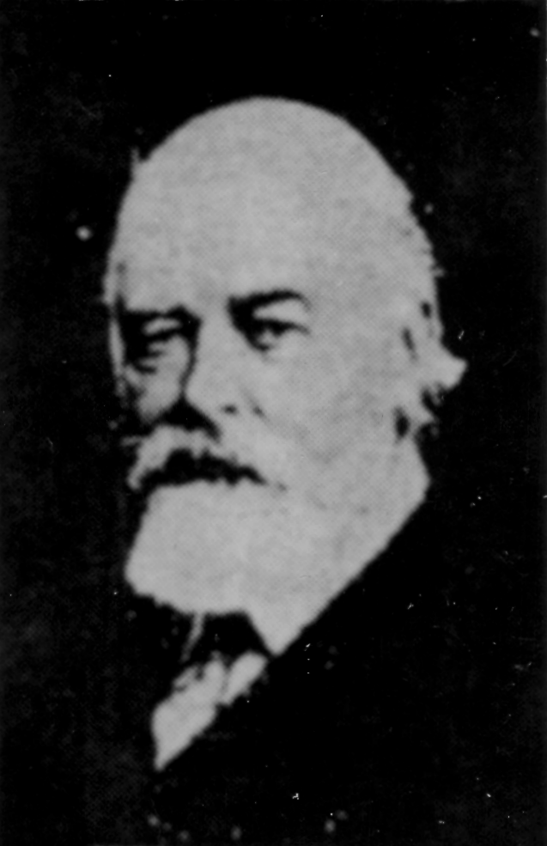
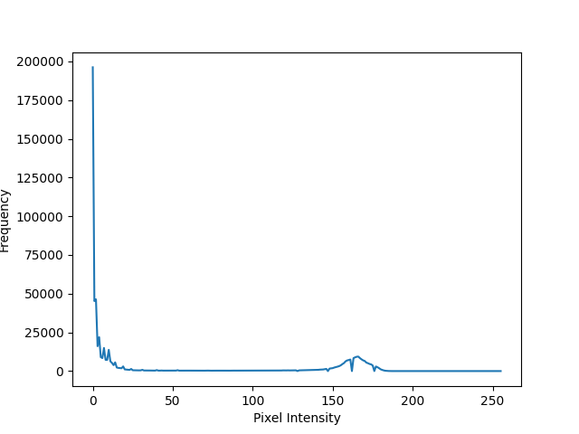
Experimental Result:
Cover Image
Stego Image
Histogram of Cover image
Histogram of Stego image

Slide 14
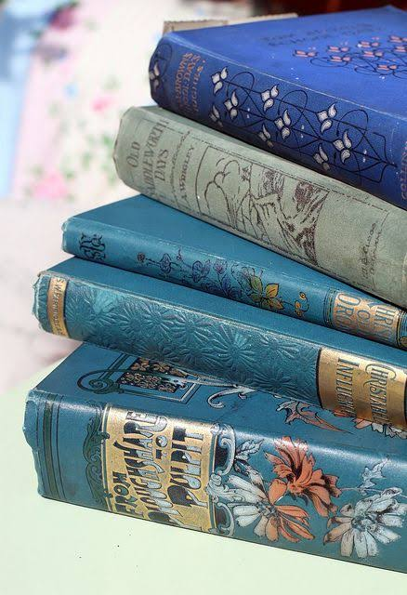

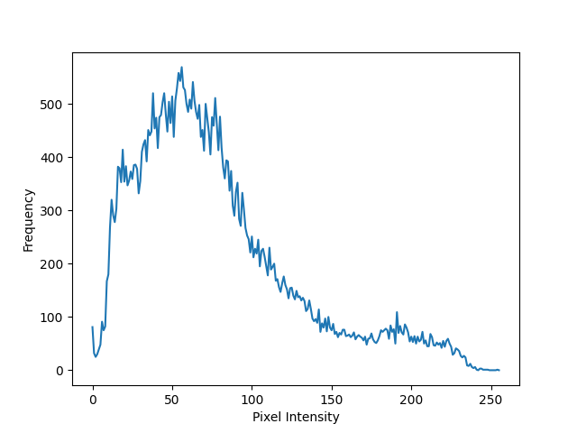
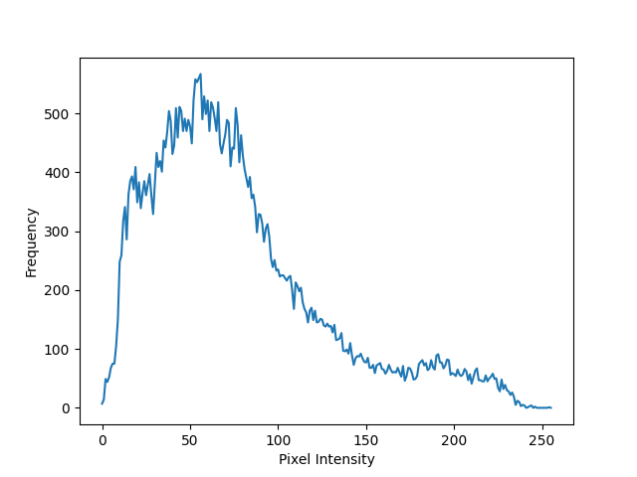
Cover Image
Stego Image
Histogram of Cover image
Histogram of Stego image

Slide 15
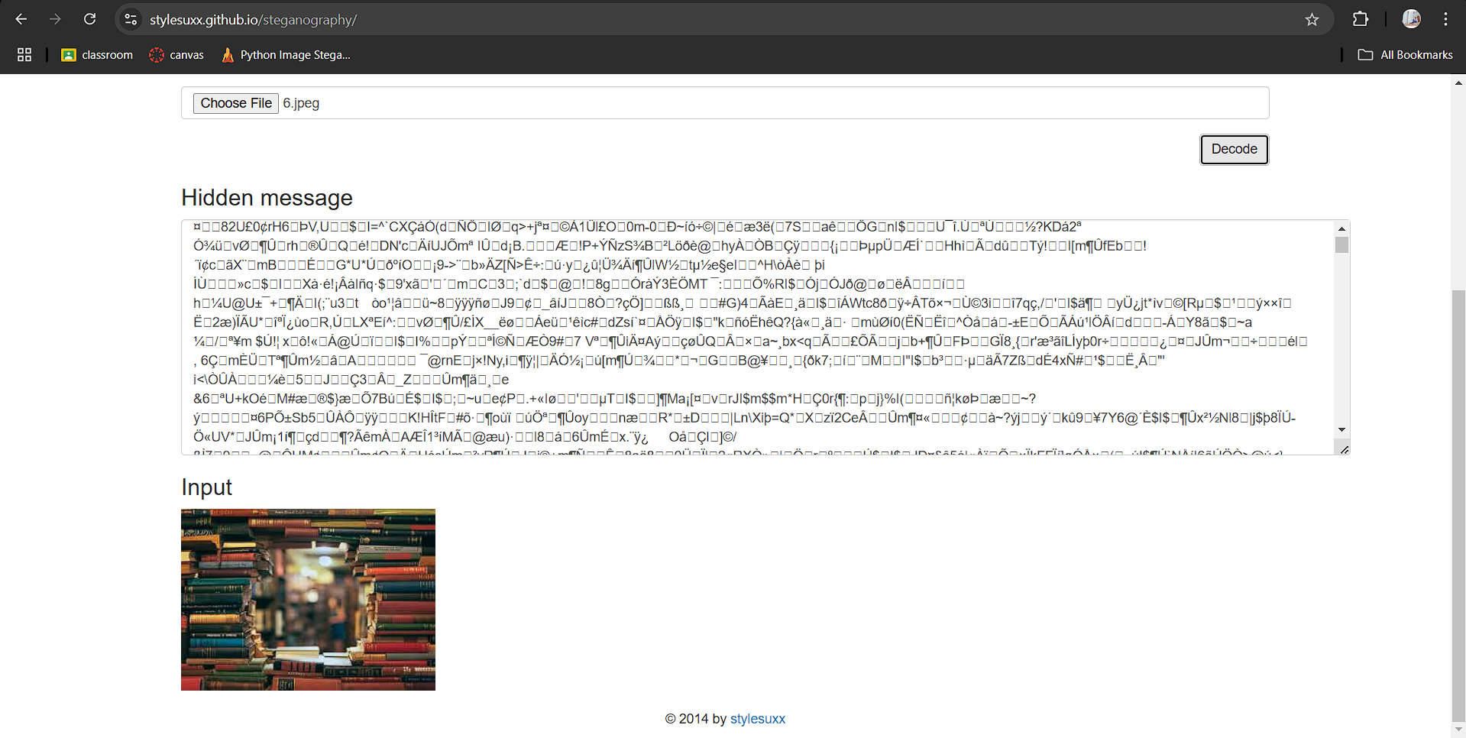
Result in
Traditional Steganography Testing:

Slide 16
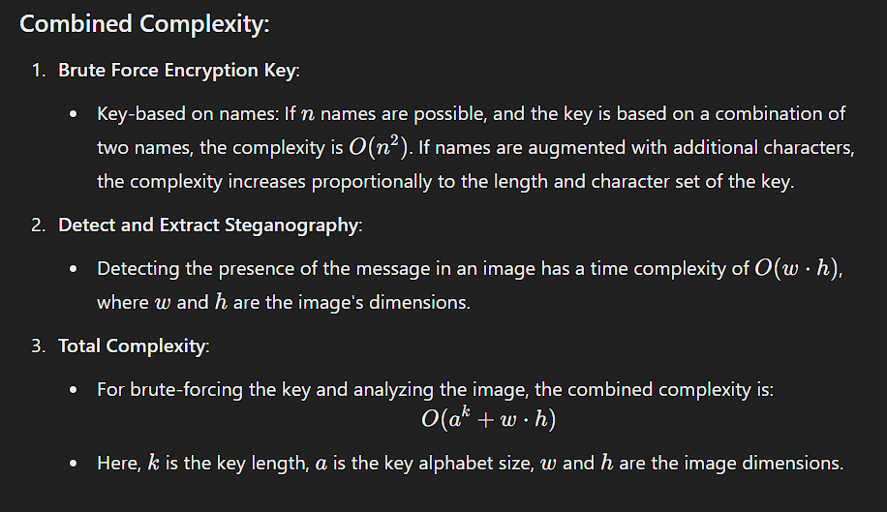
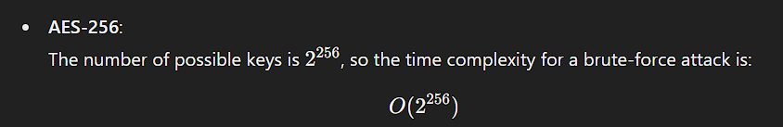
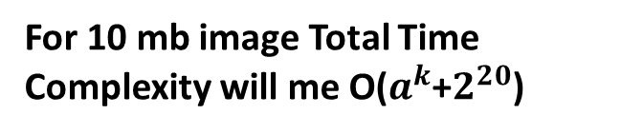
1,2
Time Complexity
To break our algorithm:
For 10 mb image Total Time Complexity will me O($a^{k}$+$2^{20}$)
Time Complexity
To break AES-256:

Slide 17
Comparison with Traditional Steganography Techniques
3,4
Feature | Provided Algorithm | Traditional LSB Steganography | DCT-Based Steganography
Embedding | Embeds binary data into LSBs of the blue channel. | Embeds into LSBs of RGB or grayscale channels. | Modifies coefficients in Discrete Cosine Transform blocks.
Robustness | Vulnerable to noise and compression artifacts. | Similar vulnerabilities. | More robust to compression and tampering.
Detection Difficulty | Moderate, as pattern cycling adds slight complexity. | Easy to detect with statistical analysis. | Harder to detect with statistical methods.
Capacity | Max Message size is One third of image size. | Limited by image size. | Depends on compression level; usually lower.
Performance | Fast due to simplicity. | Similar performance. | Slower due to transform-domain operations.

Slide 18
Future Scope:-
Explore asymmetric cryptography for secure key exchange.
Enable embedding data in audio and video files for versatile use cases.
Future implementation could support compressed data embedding for improved efficiency.
For Realtime communication WebSocket protocol will be applied
Transition the current web application into a fully responsive platform for seamless use on various devices.

Slide 19
Conclusion:-
This project bridges the gap between security and usability by integrating image steganography with cryptographic techniques. It ensures secure and confidential communication by embedding encrypted messages into images, which are automatically deleted after retrieval, leaving no trace of the conversation. Future enhancements aim to make the system more robust, versatile, and user-friendly, ultimately offering a powerful tool for secure communication in an increasingly surveillance-driven digital world.

Slide 20
References:-
https://en.wikipedia.org/wiki/History_of_cryptography
https://en.wikipedia.org/wiki/Outline_of_cryptography
https://plato.stanford.edu/entries/trithemius/
https://www.sciencedirect.com/topics/computer-science/steganography
https://www.worldscientific.com/

